Slide 1



tile
Atliq Hardwares
Consumer Goods Ad hoc Insights
Presented by :- Manish Kumar
Notes:
textbox
No alt text provided
image
No alt text provided
textbox
No alt text provided
image
No alt text provided
image
No alt text provided

Slide 2




tile
Overview of Company
About Data
Agenda
Objective
Ad Hoc Request with Insights
Notes:
textbox
No alt text provided
image
No alt text provided
textbox
No alt text provided
image
No alt text provided
image
No alt text provided

Slide 3
tile
Atliq Hardware is one of the leading computer hardware producers in India as well as 26 other countries across the globe.
Manufactures products under 3 major divisions i.e., Peripherals & Accessories, PC, Networking & Storage.
We have a total of 74 Customers like Neptune, Sage, Leader, Vijay Sales etc. across all markets/countries.
Overview of Company
Notes:
textbox
No alt text provided
image
No alt text provided
textbox
No alt text provided
image
No alt text provided
image
No alt text provided

Slide 4
tile
In Data there are 6 Tables
Dim_product
Dim_customer
Fact_gross_price
Category
Division
Product
Product_code
Segment
varient
Channel
Customer
Customer_code
Market
Platform
Region
Sub_zone
Fiscal_year
Gross_price
Product_code
About Data
Fact_manufacturing_cost
Fact_sales_monthly
Fact_pre_invoice_deductions
Cost_year
Manufacturing_cost
Product_code
Customer_code
date
Fiscal_year
Product_code
Sold_quantity
Customer_code
Fiscal_year
Pre_invoice_discount_pct
Notes:
textbox
No alt text provided
image
No alt text provided
textbox
No alt text provided
image
No alt text provided
image
No alt text provided

Slide 5
tile
Assist the management team to gain more insights about the business
Take data-driven decisions to scale business
Objective
Notes:
textbox
No alt text provided
image
No alt text provided
textbox
No alt text provided
image
No alt text provided
image
No alt text provided

Slide 6
tile
Ad Hoc request to get the enough insight to make quick and smart data informed decision.
So Ad Hoc give the 10 question so by solving the question we know about the data more clearly and we know about in which country over sale more, which product sales more, which product is more sale able and many more.
So let start the Question with SQL Query, output and Visual graph.
Ad Hoc Request with Insights
Notes:
textbox
No alt text provided
image
No alt text provided
textbox
No alt text provided
image
No alt text provided
image
No alt text provided

Slide 7
page2
PRODUCT LINE-UP AT ATLIQ HARDWARE
Personal Computer
Peripheral & Accessories
Network & Storage
(PC)
(P & A)
(N & S)
Desktop
Notebook
Peripherals
Accessories
Networking
Storage
Business Laptop
Gamming Laptop
Graphic Card
Batteries
Wifi Extender
External SSD
Personal Laptop
Business Laptop
Internal HDD
Keyboard
USB Flash Drive
Personal Laptop
Mother Board
Mouse
Processors
Notes:
textbox
No alt text provided
shape
No alt text provided
textbox
No alt text provided
shape
No alt text provided
shape
No alt text provided
shape
No alt text provided
textbox
No alt text provided
shape
No alt text provided
textbox
No alt text provided
shape
No alt text provided
textbox
No alt text provided
shape
No alt text provided
shape
No alt text provided
shape
No alt text provided
textbox
No alt text provided
textbox
No alt text provided
shape
No alt text provided
textbox
No alt text provided
shape
No alt text provided
textbox
No alt text provided
shape
No alt text provided
textbox
No alt text provided
textbox
No alt text provided
shape
No alt text provided
shape
No alt text provided
shape
No alt text provided
textbox
No alt text provided
shape
No alt text provided
textbox
No alt text provided
shape
No alt text provided
textbox
No alt text provided
shape
No alt text provided
shape
No alt text provided
shape
No alt text provided
textbox
No alt text provided
textbox
No alt text provided
shape
No alt text provided
textbox
No alt text provided
textbox
No alt text provided
shape
No alt text provided

Slide 8
tile
Let Start the Ad Hoc Question with SQL Query, Output and Data Visual
Notes:
textbox
No alt text provided
image
No alt text provided
textbox
No alt text provided
image
No alt text provided
image
No alt text provided

Slide 9
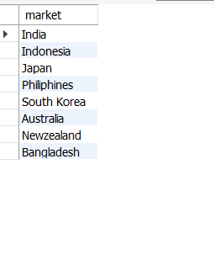
tile
Output
Question 1
1. Provide the list of markets in which customer "Atliq Exclusive" operates its business in the APAC region?
Notes:
textbox
No alt text provided
image
No alt text provided
textbox
No alt text provided
image
No alt text provided
image
No alt text provided

Slide 10
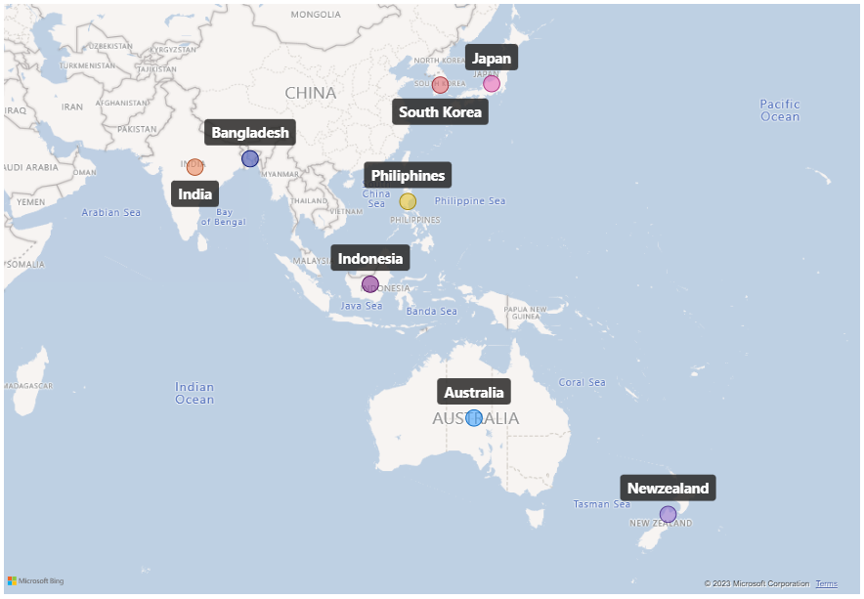
tile
Insights
Atliq Exclusive Customer in APAC Region
Atliq Exclusive customer of Atliq Hardware operates its business in 8 major markets of Asia Pacific region.
Notes:
textbox
No alt text provided
image
No alt text provided
textbox
No alt text provided
image
No alt text provided
image
No alt text provided

Slide 11
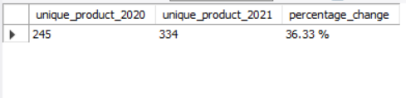
tile
Output
Question 2
2. What is the percentage of unique product increase in 2021 vs. 2020?
The final output contains these fields, unique_products_2020
unique_products_2021
percentage_chg
Notes:
textbox
No alt text provided
image
No alt text provided
textbox
No alt text provided
image
No alt text provided
image
No alt text provided

Slide 12
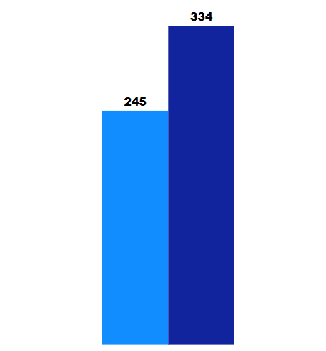
tile
Insights
Unique Product Increase in year 2020 to 2021
36.33 %
Product count 2020
Product count 2021
2020
2021
There was an Increase in unique product 2020 Vs unique product 2021 by 36.33%.
Notes:
textbox
No alt text provided
image
No alt text provided
textbox
No alt text provided
image
No alt text provided
image
No alt text provided

Slide 13
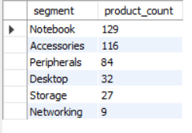
tile
Output
Question 3
3. Provide a report with all the unique product counts for each segment and sort them in descending order of product counts.
The final output contains 2 fields, segment product_count
Notes:
textbox
No alt text provided
image
No alt text provided
textbox
No alt text provided
image
No alt text provided
image
No alt text provided

Slide 14
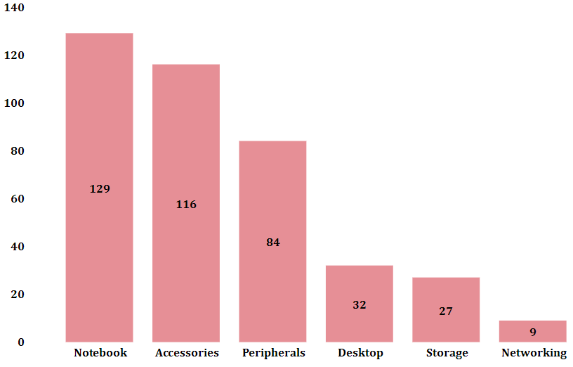
tile
Insights
Each Segment Unique Product Count Graph
From the graph we know there are 6 segment and the product count of every segment.
In which Notebook Segment have the highest product count 129 and the networking segment have the lowest product count 9
Notes:
textbox
No alt text provided
image
No alt text provided
textbox
No alt text provided
image
No alt text provided
image
No alt text provided

Slide 15
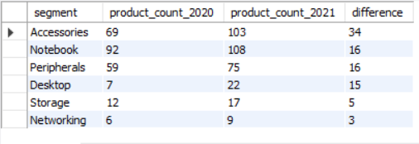
tile
Output
Question 4
4. Follow-up: Which segment had the most increase in unique products in 2021 vs 2020?
The final output contains these fields, segment product_count_2020 product_count_2021 difference
Notes:
textbox
No alt text provided
image
No alt text provided
textbox
No alt text provided
image
No alt text provided
image
No alt text provided

Slide 16
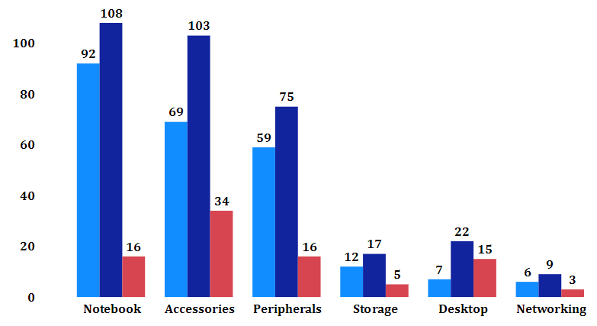
tile
Insights
Which Segment have Most Increase in Unique Product in 2020 Vs 2021
Product count 2020
Most Increase in Unique Product were seen in only three Categories Accessories, Notebook and Peripherals.
Desktop segment have also increase more in 2021 from the 2020
The lowest product increase in storage and networking segment.
Product count 2021
Difference
Notes:
textbox
No alt text provided
image
No alt text provided
textbox
No alt text provided
image
No alt text provided
image
No alt text provided

Slide 17
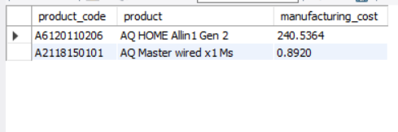
tile
Output
Question 5
5. Get the products that have the highest and lowest manufacturing costs.
The final output should contain these fields, product_code, product, manufacturing_cost .
Notes:
textbox
No alt text provided
image
No alt text provided
textbox
No alt text provided
image
No alt text provided
image
No alt text provided

Slide 18


tile
Insights
Product have the Highest and the Lowest Manufacturing Cost
Highest manufacturing cost
Lowest manufacturing cost
240.54
0.89
AQ HOME Allin1 Gen 2 (Plus 3)
Category: Personal Desktop
AQ Master wired x1 Ms (Standard 1)
Category: Mouse
Notes:
textbox
No alt text provided
image
No alt text provided
textbox
No alt text provided
image
No alt text provided
image
No alt text provided

Slide 19
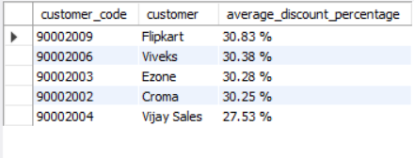
tile
Output
Question 6
6. Generate a report which contains the top 5 customers who received an average high pre_invoice_discount_pct for the fiscal year 2021 and in the Indian market.
The final output contains these fields, customer_code , customer, average_discount_percentage.
Notes:
textbox
No alt text provided
image
No alt text provided
textbox
No alt text provided
image
No alt text provided
image
No alt text provided

Slide 20
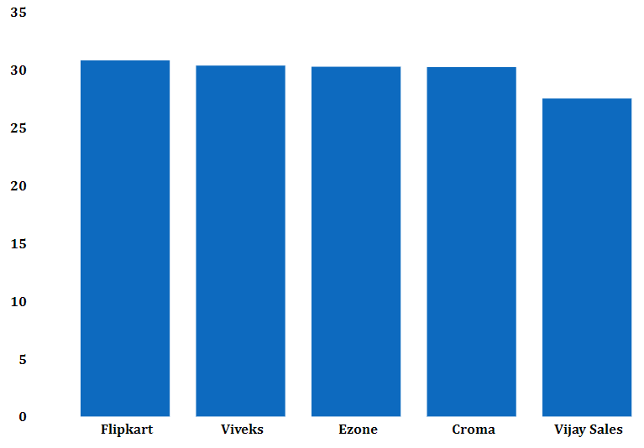
tile
Insights
Top 5 Average High Discount Percentage Customer in India in FY 2021
In India the year 2021 the top 5 average discount percentage customer are Flipkart, Viveks, Ezone, Croma, Vijay Sales they all have similar discount percentage. All have approx. 30% except Vijay Sales which have 27.53%.
30.83 %
30.38 %
30.28 %
30.25 %
27.53 %
Notes:
textbox
No alt text provided
image
No alt text provided
textbox
No alt text provided
image
No alt text provided
image
No alt text provided

Slide 21
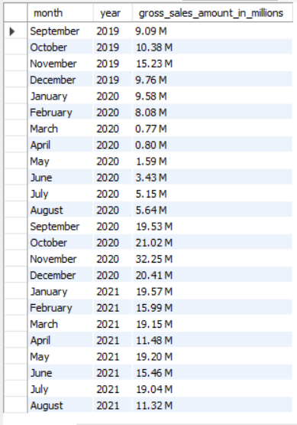
tile
Output
Question 7
7. Get the complete report of the Gross sales amount for the customer “Atliq Exclusive” for each month. This analysis helps to get an idea of low and high-performing months and take strategic decisions.
The final report contains these columns: Month, Year Gross sales Amount.
Notes:
textbox
No alt text provided
image
No alt text provided
textbox
No alt text provided
image
No alt text provided
image
No alt text provided

Slide 22
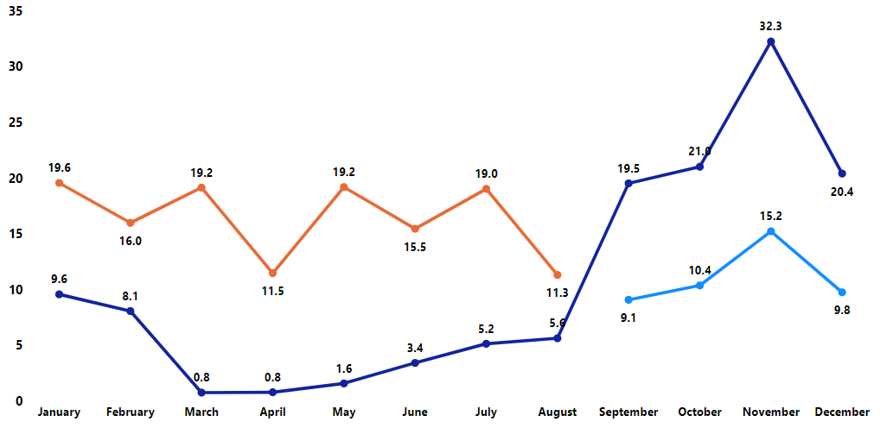
tile
Insights
Annual Gross sales amount for Atliq Exclusive Customer
For Atliq Exclusive customer , It is clear that November month of 2020 marked the highest sales which is a good sales after the impact of the COVID-19.
The lowest sales recorded on march 2020 due to the COVID-19.
2019
2020
2021
Notes:
textbox
No alt text provided
image
No alt text provided
textbox
No alt text provided
image
No alt text provided
image
No alt text provided

Slide 23
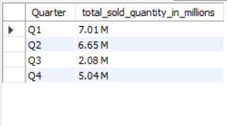
tile
Output
Question 8
8. In which quarter of 2020, got the maximum total_sold_quantity?
The final output contains these fields sorted by the total_sold_quantity, Quarter total_sold_quantity
Notes:
textbox
No alt text provided
image
No alt text provided
textbox
No alt text provided
image
No alt text provided
image
No alt text provided

Slide 24
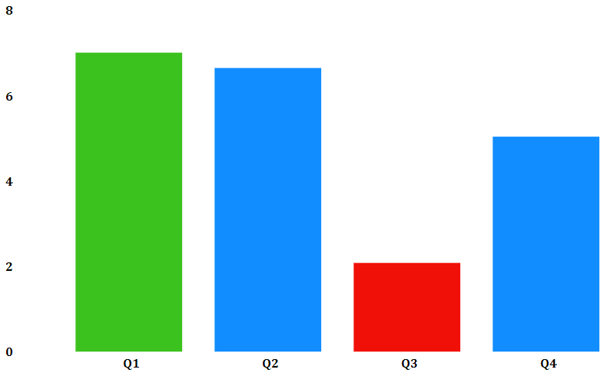
tile
Insights
Total Sold Quantity in 2020 Quarterly
7.01 M
Quarter 1 has the maximum total sold quantity which is 7.01M.
Due to the effect of COVID-19 the sold quantity decrease in quarter 3.
But we start recovering very quickly in quarter 4 over total sold quantity increase by 2.96M from the previous quarter.
6.65 M
5.04 M
COVID-19
2.08 M
Notes:
textbox
No alt text provided
image
No alt text provided
textbox
No alt text provided
image
No alt text provided
image
No alt text provided

Slide 25
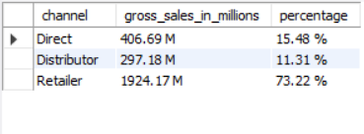
tile
Output
Question 9
9. Which channel helped to bring more gross sales in the fiscal year 2021 and the percentage of contribution?
The final output contains these fields, channel gross_sales_millions, percentage.
Notes:
textbox
No alt text provided
image
No alt text provided
textbox
No alt text provided
image
No alt text provided
image
No alt text provided

Slide 26
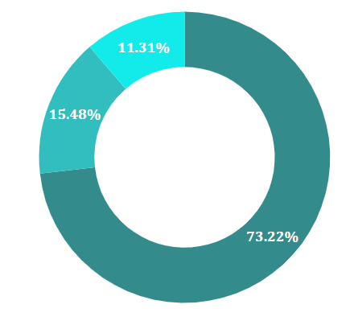
tile
Insights
Gross Sales in Fiscal Year 2021 by the Channel
The highest sales in year 2021 bring by the Retailer channel which is 73.22% of the total sales.
Then the Direct channel bring the 15.48% sales of the total sales.
And the Distributor channel bring the 11.31% sales of the total sales.
297.18 M
Retailer
Direct
406.69 M
Distributor
1924.17 M
Notes:
textbox
No alt text provided
image
No alt text provided
textbox
No alt text provided
image
No alt text provided
image
No alt text provided

Slide 27
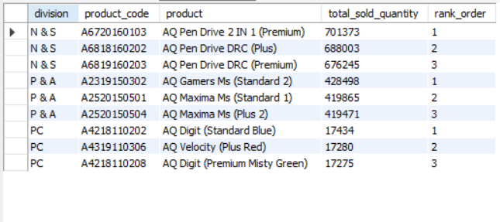
tile
Output
Question 10
10. Get the Top 3 products in each division that have a high total_sold_quantity in the fiscal_year 2021?
The final output contains these fields, division product_code, product, total_sold_quantity, rank_order?
Notes:
textbox
No alt text provided
image
No alt text provided
textbox
No alt text provided
image
No alt text provided
image
No alt text provided

Slide 28
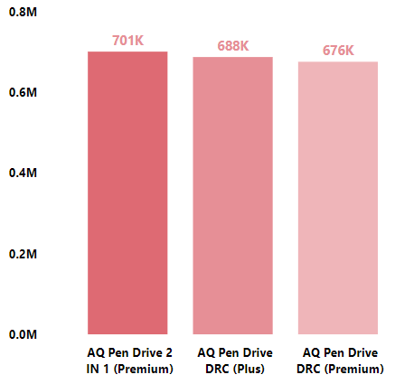
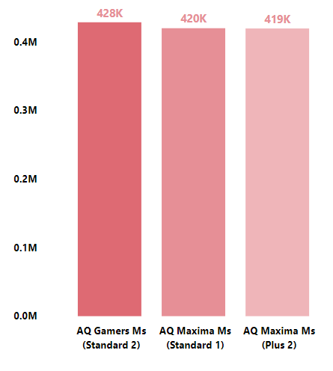
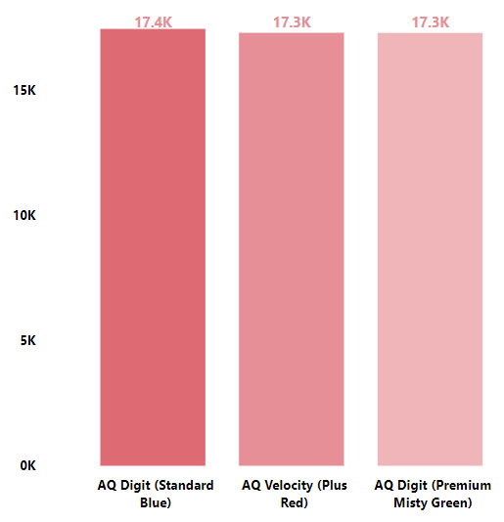
tile
Insights
Total Sold Quantity of Top 3 Product of each division in fiscal year 2021
N & S
P & A
PC
Top 3 Product in N&S division are AQ Pen Drive 2 in 1 (Premium), AQ Pen Drive DRC (Plus) and AQ Pen Drive DRC (Premium), the Average total sold quantity of 3 product is approx. 688.33K
Top 3 Product in P&A division are AQ Gamers Ms (Standard), AQ Maxima Ms (Sandard), AQ Maxima Ms (Plus 2) the Average total sold quantity of 3 product is approx. 422.33K
Top 3 Product in PC division are AQ Digit (Standard Blue), AQ Velocity (Plus Red), AQ Digit (Premium Misty Green) the Average total sold quantity of 3 product is approx. 17.33K
Notes:
textbox
No alt text provided
image
No alt text provided
textbox
No alt text provided
image
No alt text provided
image
No alt text provided

Slide 29
tile
Thank You
Notes:
textbox
No alt text provided
image
No alt text provided
textbox
No alt text provided
image
No alt text provided
image
No alt text provided

